Slide 1
Hadoop Ecosystem
Giao hàng tiết kiệm - Master DEV – 11/2019

Slide 2
Nội dung
Bigdata Ecosystem
Hadoop Ecosystem
Apache Hadoop
Apache Spark
Apache Kafka
Bigdata Stack GHTK

Slide 3
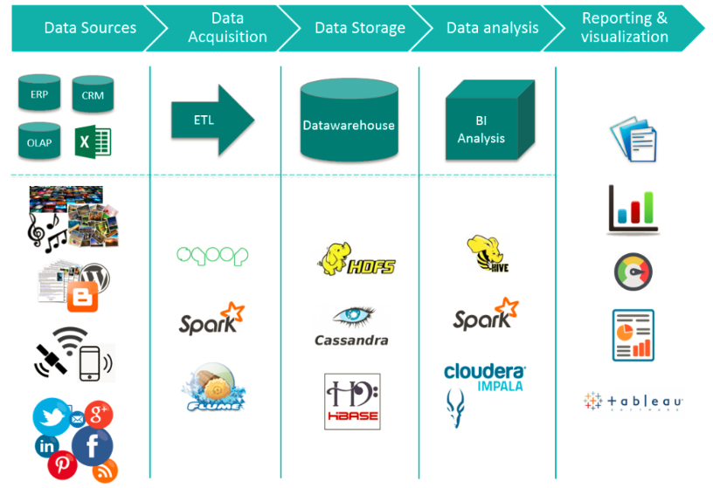
1. Bigdata Ecosystem

Slide 4
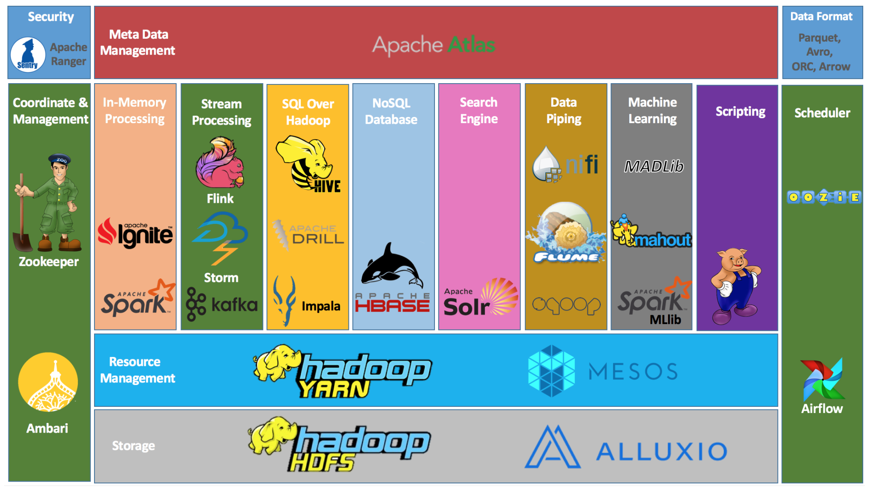
2. Hadoop Ecosystem
Notes:
https://subscription.packtpub.com/book/application_development/9781788995092/1/ch01lvl1sec14/overview-of-the-hadoop-ecosystem
https://data-flair.training/blogs/hadoop-architecture/
https://data-flair.training/blogs/hadoop-hdfs-architecture/

Slide 5
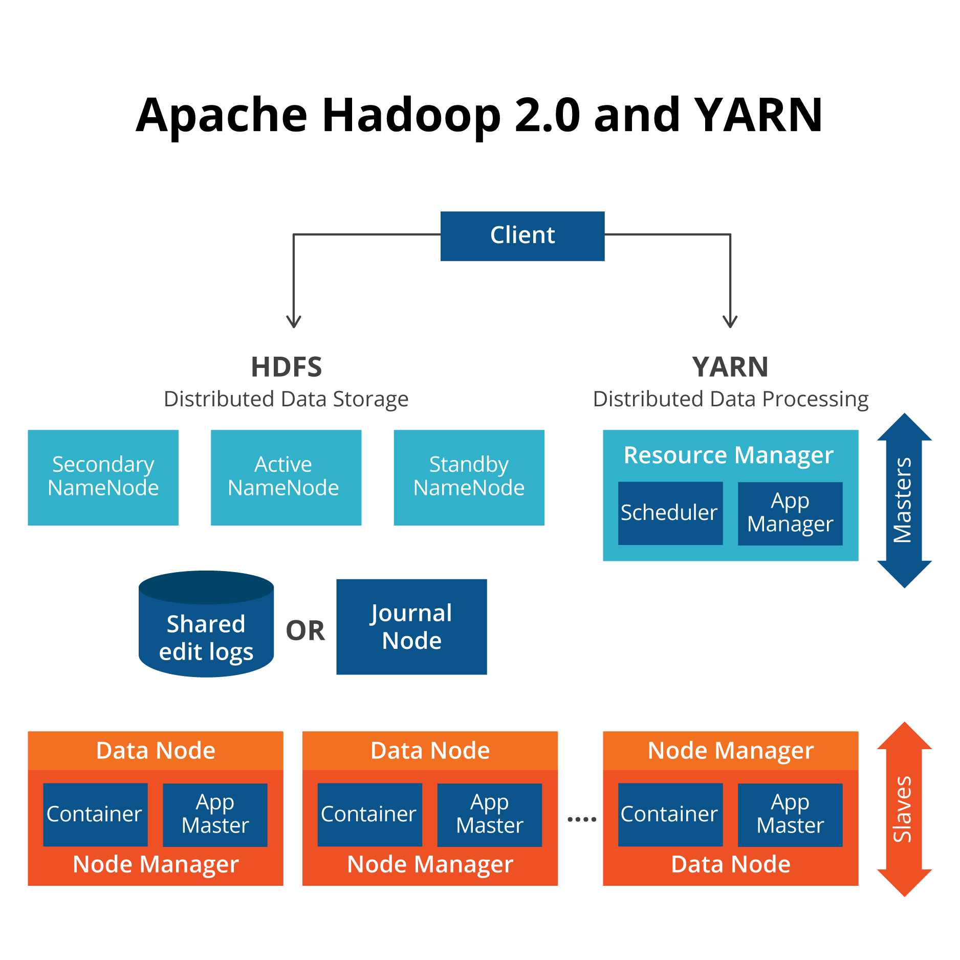
3. Apache Hadoop
Notes:
https://www.cloudera.com/products/open-source/apache-hadoop.html
https://mapr.com/why-hadoop/why-mapr/architecture-matters/
https://www.dezyre.com/article/hadoop-ecosystem-components-and-its-architecture/114
https://www.slideshare.net/EdurekaIN/hadoop-architecture-and-hdfs
https://subscription.packtpub.com/book/application_development/9781788995092/1/ch01lvl1sec14/overview-of-the-hadoop-ecosystem
https://www.quora.com/Can-you-please-discuss-a-little-bit-about-big-data-ecosystem-players-platforms-components-and-examples-of-methodologies
https://www.google.com/search?q=hadoop+architecture&sxsrf=ACYBGNSjQwdpTdY5xZ2k3g9rIT_j3iHv9Q:1572929984050&source=lnms&tbm=isch&sa=X&ved=0ahUKEwj-utLnpNLlAhUUzmEKHfOSAZkQ_AUIEigB&biw=1920&bih=937#imgrc=JXcmv2bv_SWZAM:

Slide 6
Hadoop Architecture
Hadoop provides 3 main layers:
HDFS: Distributed Storage Layer
YARN: Resource Management Layer
MapReduce: Distributed Processing Layer
Notes:
https://www.cloudera.com/products/open-source/apache-hadoop.html
https://mapr.com/why-hadoop/why-mapr/architecture-matters/
https://www.dezyre.com/article/hadoop-ecosystem-components-and-its-architecture/114
https://www.slideshare.net/EdurekaIN/hadoop-architecture-and-hdfs
https://subscription.packtpub.com/book/application_development/9781788995092/1/ch01lvl1sec14/overview-of-the-hadoop-ecosystem
https://www.quora.com/Can-you-please-discuss-a-little-bit-about-big-data-ecosystem-players-platforms-components-and-examples-of-methodologies
https://www.google.com/search?q=hadoop+architecture&sxsrf=ACYBGNSjQwdpTdY5xZ2k3g9rIT_j3iHv9Q:1572929984050&source=lnms&tbm=isch&sa=X&ved=0ahUKEwj-utLnpNLlAhUUzmEKHfOSAZkQ_AUIEigB&biw=1920&bih=937#imgrc=JXcmv2bv_SWZAM:

Slide 7
HDFS – Distributed Storage Layer

Slide 8
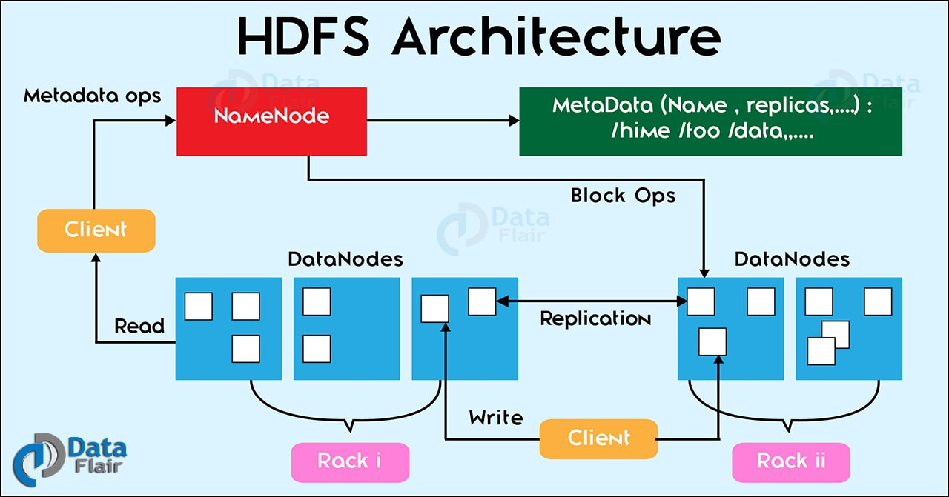
HDFS - Architecture
Notes:
https://www.cloudera.com/products/open-source/apache-hadoop.html
https://mapr.com/why-hadoop/why-mapr/architecture-matters/
https://www.dezyre.com/article/hadoop-ecosystem-components-and-its-architecture/114
https://www.slideshare.net/EdurekaIN/hadoop-architecture-and-hdfs
https://subscription.packtpub.com/book/application_development/9781788995092/1/ch01lvl1sec14/overview-of-the-hadoop-ecosystem
https://www.quora.com/Can-you-please-discuss-a-little-bit-about-big-data-ecosystem-players-platforms-components-and-examples-of-methodologies
https://www.google.com/search?q=hadoop+architecture&sxsrf=ACYBGNSjQwdpTdY5xZ2k3g9rIT_j3iHv9Q:1572929984050&source=lnms&tbm=isch&sa=X&ved=0ahUKEwj-utLnpNLlAhUUzmEKHfOSAZkQ_AUIEigB&biw=1920&bih=937#imgrc=JXcmv2bv_SWZAM:

Slide 9
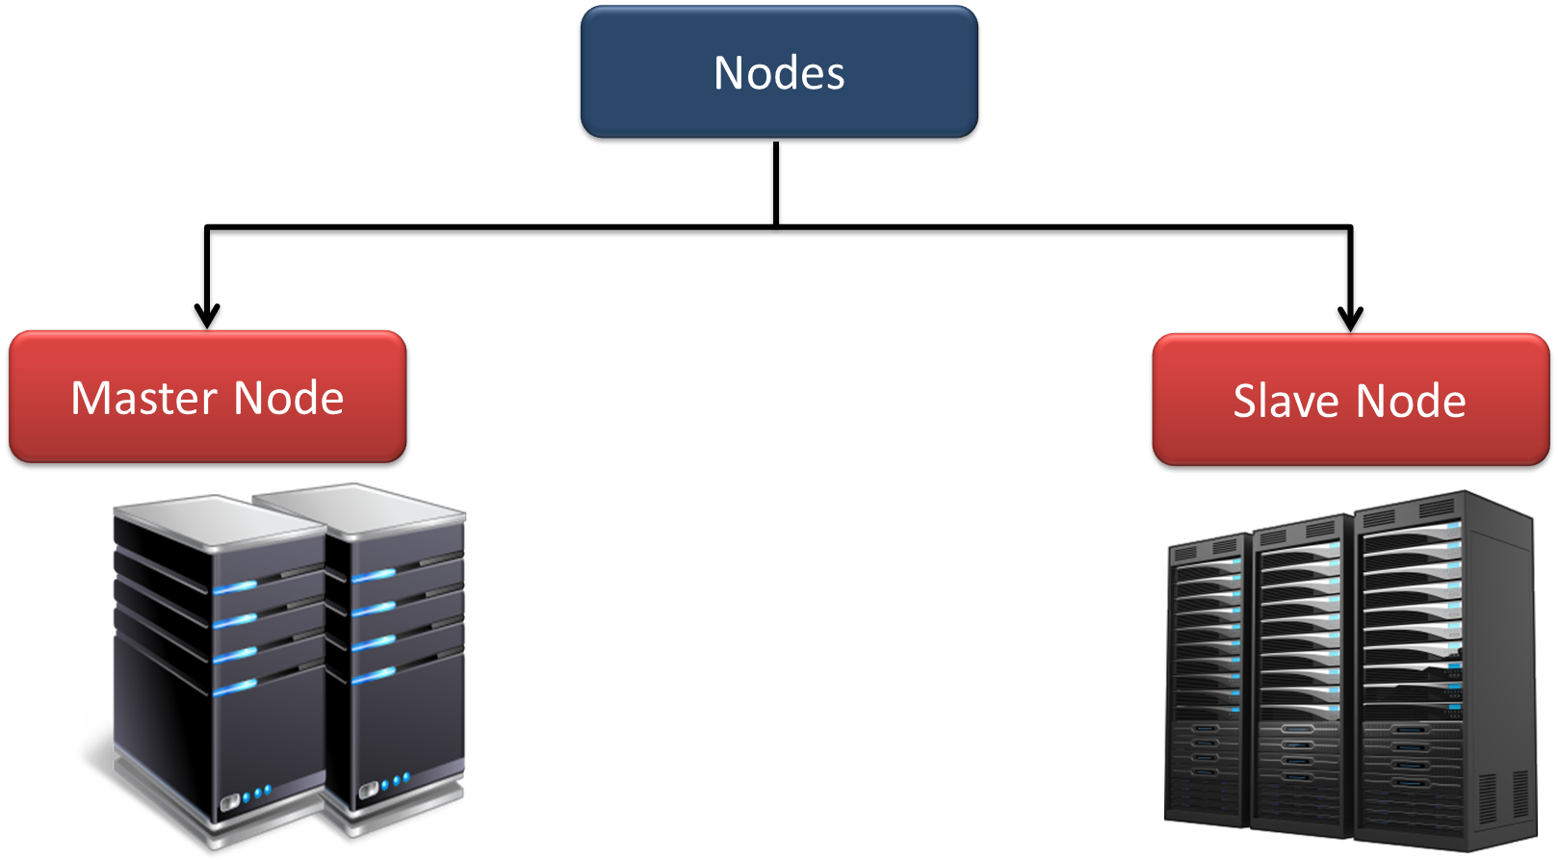
HDFS – Components (Nodes)
HDFS is distributed file system, have 2 main components:
Namenode: manages HDFS Metadata and Edit log, regulates file access to the clients.
Datanode: stores HDFS data in files in its local file system.
Notes:
https://www.cloudera.com/products/open-source/apache-hadoop.html
https://mapr.com/why-hadoop/why-mapr/architecture-matters/
https://www.dezyre.com/article/hadoop-ecosystem-components-and-its-architecture/114
https://www.slideshare.net/EdurekaIN/hadoop-architecture-and-hdfs
https://subscription.packtpub.com/book/application_development/9781788995092/1/ch01lvl1sec14/overview-of-the-hadoop-ecosystem
https://www.quora.com/Can-you-please-discuss-a-little-bit-about-big-data-ecosystem-players-platforms-components-and-examples-of-methodologies
https://www.google.com/search?q=hadoop+architecture&sxsrf=ACYBGNSjQwdpTdY5xZ2k3g9rIT_j3iHv9Q:1572929984050&source=lnms&tbm=isch&sa=X&ved=0ahUKEwj-utLnpNLlAhUUzmEKHfOSAZkQ_AUIEigB&biw=1920&bih=937#imgrc=JXcmv2bv_SWZAM:

Slide 10
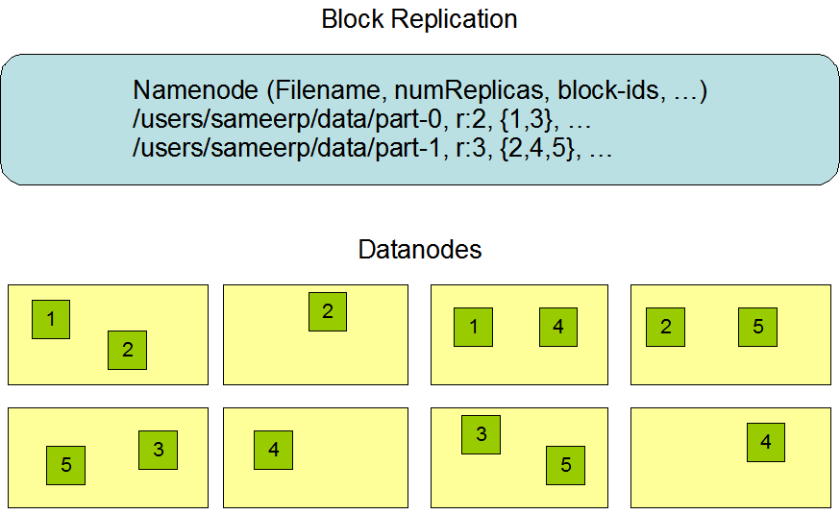
HDFS - Components
Notes:
https://www.cloudera.com/products/open-source/apache-hadoop.html
https://mapr.com/why-hadoop/why-mapr/architecture-matters/
https://www.dezyre.com/article/hadoop-ecosystem-components-and-its-architecture/114
https://www.slideshare.net/EdurekaIN/hadoop-architecture-and-hdfs
https://subscription.packtpub.com/book/application_development/9781788995092/1/ch01lvl1sec14/overview-of-the-hadoop-ecosystem
https://www.quora.com/Can-you-please-discuss-a-little-bit-about-big-data-ecosystem-players-platforms-components-and-examples-of-methodologies
https://www.google.com/search?q=hadoop+architecture&sxsrf=ACYBGNSjQwdpTdY5xZ2k3g9rIT_j3iHv9Q:1572929984050&source=lnms&tbm=isch&sa=X&ved=0ahUKEwj-utLnpNLlAhUUzmEKHfOSAZkQ_AUIEigB&biw=1920&bih=937#imgrc=JXcmv2bv_SWZAM:

Slide 11
HDFS – Read Operation
Notes:
https://data-flair.training/blogs/hdfs-data-write-operation/

Slide 12
HDFS – Write Operation
Notes:
https://data-flair.training/blogs/hdfs-data-write-operation/

Slide 13
HDFS – Native Features
Default - important features in HDFS:
Distributed Storage
Replication
High Availability
Data Reliability
Fault Tolerant
Scalability
High throughput
Notes:
https://www.cloudera.com/products/open-source/apache-hadoop.html
https://mapr.com/why-hadoop/why-mapr/architecture-matters/
https://www.dezyre.com/article/hadoop-ecosystem-components-and-its-architecture/114
https://www.slideshare.net/EdurekaIN/hadoop-architecture-and-hdfs
https://subscription.packtpub.com/book/application_development/9781788995092/1/ch01lvl1sec14/overview-of-the-hadoop-ecosystem
https://www.quora.com/Can-you-please-discuss-a-little-bit-about-big-data-ecosystem-players-platforms-components-and-examples-of-methodologies
https://www.google.com/search?q=hadoop+architecture&sxsrf=ACYBGNSjQwdpTdY5xZ2k3g9rIT_j3iHv9Q:1572929984050&source=lnms&tbm=isch&sa=X&ved=0ahUKEwj-utLnpNLlAhUUzmEKHfOSAZkQ_AUIEigB&biw=1920&bih=937#imgrc=JXcmv2bv_SWZAM:

Slide 14
HDFS – Other features
Namenode High Availability
Distributed Cache
Rack Awareness
Federation
Erasure Coding
Notes:
https://data-flair.training/blogs/hdfs-data-write-operation/

Slide 15
Yarn – Resource Management Layer

Slide 16
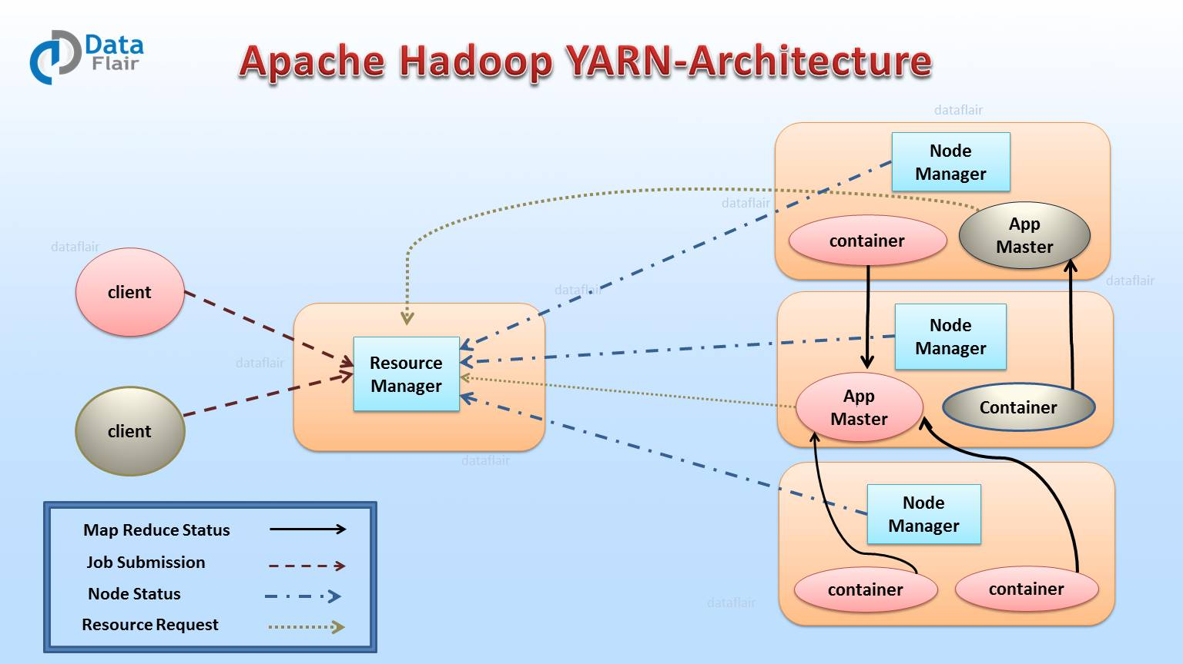
Yarn – Architecture
Yarn have 2 main components:
Resource Manager is the ultimate authority that arbitrates resources among all the applications in the system.
Node Manager is the per-machine framework agent who is responsible for containers, monitoring their resource usage (cpu, memory, disk, network) and reporting the same to the ResourceManager/Scheduler.
Notes:
https://data-flair.training/blogs/hdfs-data-write-operation/

Slide 17
Yarn – Resource Manager
Scheduler: is responsible for allocating resources to the various running applications subject to familiar constraints of capacities, queues etc.
ApplicationsManager: is responsible for accepting job-submissions, negotiating the first container for executing the application specific ApplicationMaster and provides the service for restarting the ApplicationMaster container on failure.
Notes:
https://data-flair.training/blogs/hdfs-data-write-operation/

Slide 18
MapReduce – Distributed Processing Layer

Slide 19
Hadoop Mapreduce
Hadoop MapReduce is a software framework for easily writing applications which process vast amounts of data (multi-terabyte data-sets) in-parallel on large clusters (thousands of nodes) of commodity hardware in a reliable, fault-tolerant manner.
MapReduce programming model is designed for processing large volumes of data in parallel by dividing the work into a set of independent tasks.
Notes:
https://data-flair.training/blogs/hdfs-data-write-operation/

Slide 20
Mapreduce – Concepts
MapReduce consists of two distinct task – Map and Reduce.
Map: where a block of data is read and processed to produce key-value pairs as intermediate outputs. The output of a Mapper or map task (key-value pairs) is input to the Reducer.
Reduce: The reducer receives the key-value pair from multiple map tasks. Then, the reducer aggregates those intermediate data tuples (intermediate key-value pair) into a smaller set of tuples or key-value pairs which is the final output.
In between Map and Reduce, there is small phase called Shuffle and Sort in MapReduce.

Slide 21
Mapreduce – Mapper
The map takes key/value pair as input. Whether data is in structured or unstructured format, framework converts the incoming data into key and value.
Key is a reference to the input value.
Value is the data set on which to operate.

Slide 22
Mapreduce – Reducer
Reduce takes intermediate Key / Value pairs as input and processes the output of the mapper. Usually, in the reducer, we do aggregation or summation sort of computation.
Input given to reducer is generated by Map (intermediate output)
Key / Value pairs provided to reduce are sorted by key

Slide 23
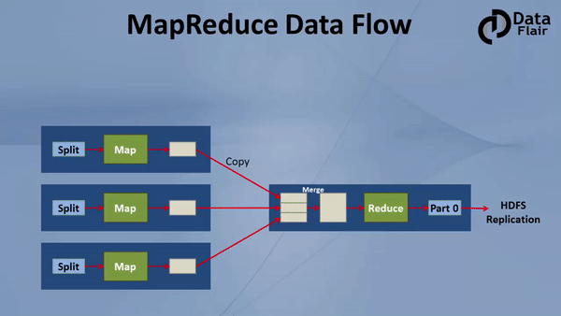
Mapreduce – How it works
Notes:
https://data-flair.training/blogs/hdfs-data-write-operation/

Slide 24
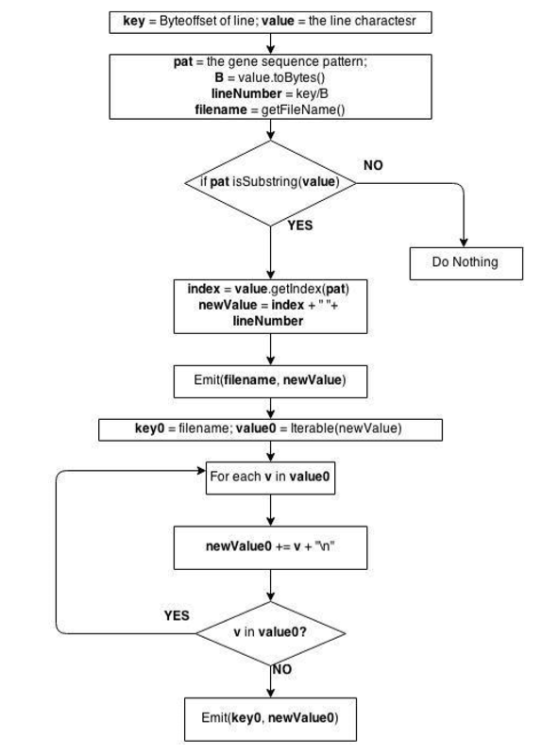
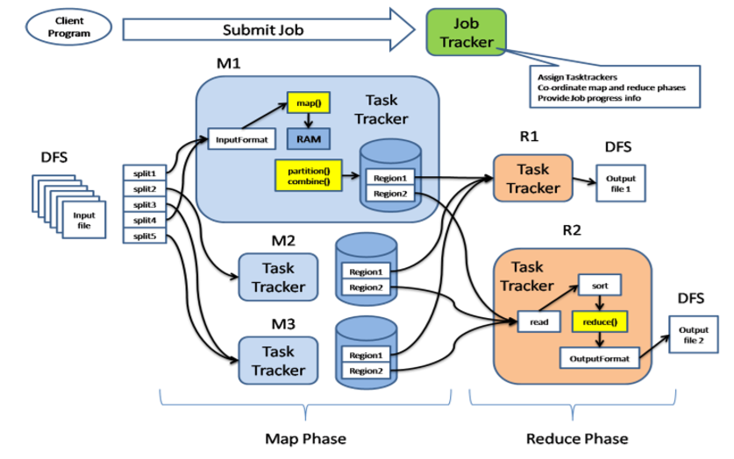
Mapreduce – How it works
Notes:
https://data-flair.training/blogs/hdfs-data-write-operation/

Slide 25
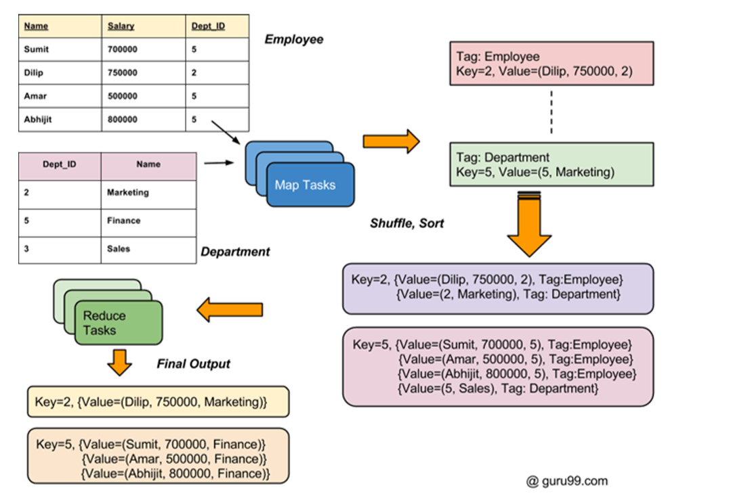
Mapreduce – How it works

Slide 26
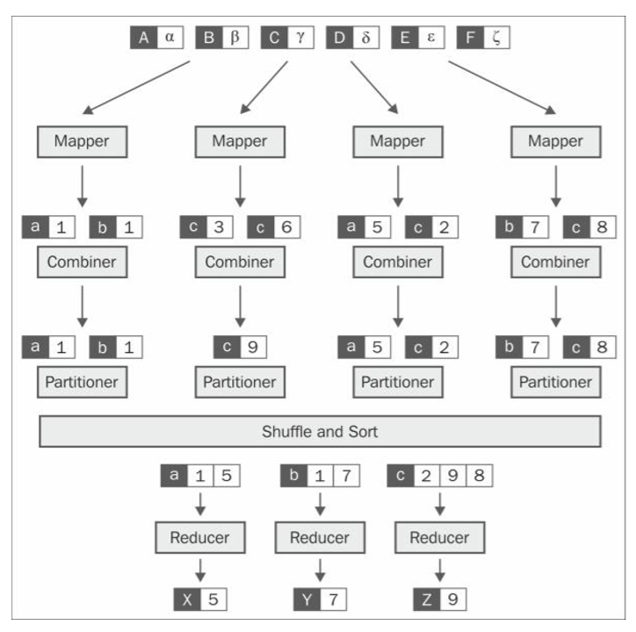
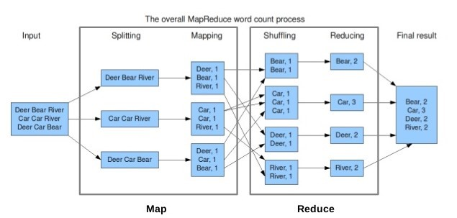
Mapreduce – How it works
Notes:
https://data-flair.training/blogs/hdfs-data-write-operation/

Slide 27
Hadoop - Usecase
Facebook runs one of the biggest Hadoop cluster that goes beyond 4,000 machines and storing more than hundreds of millions of gigabytes (2017).
Yahoo! has become the largest user of Hadoop, establishing a cluster setup comprised of 10,000 CPUs located in more than 40,000 servers with 4,500 nodes. This Hadoop cluster setup manages 455 petabytes of data for Yahoo!, which amounts to more than 1,820 times the amount of data held by the Library of Congress (2014).
Other company using Hadoop: Netflix, Uber, …
Notes:
https://bigstep.com/blog/4-lessons-learned-yahoos-massive-hadoop-cluster-setup

Slide 28
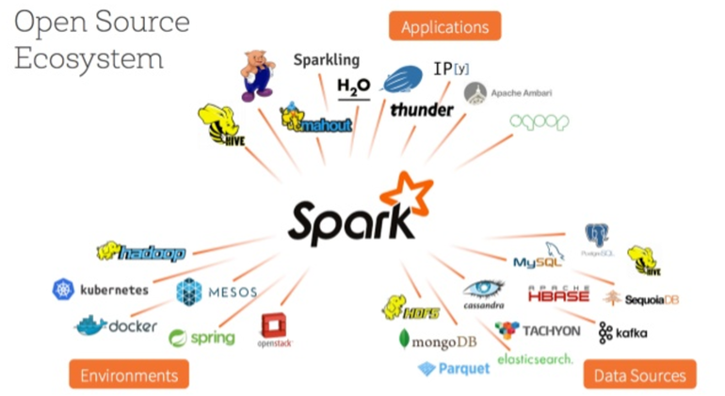
4. Apache Spark
Apache Spark™ is a unified analytics engine for large-scale data processing.
Spark Is the Glue.

Slide 29
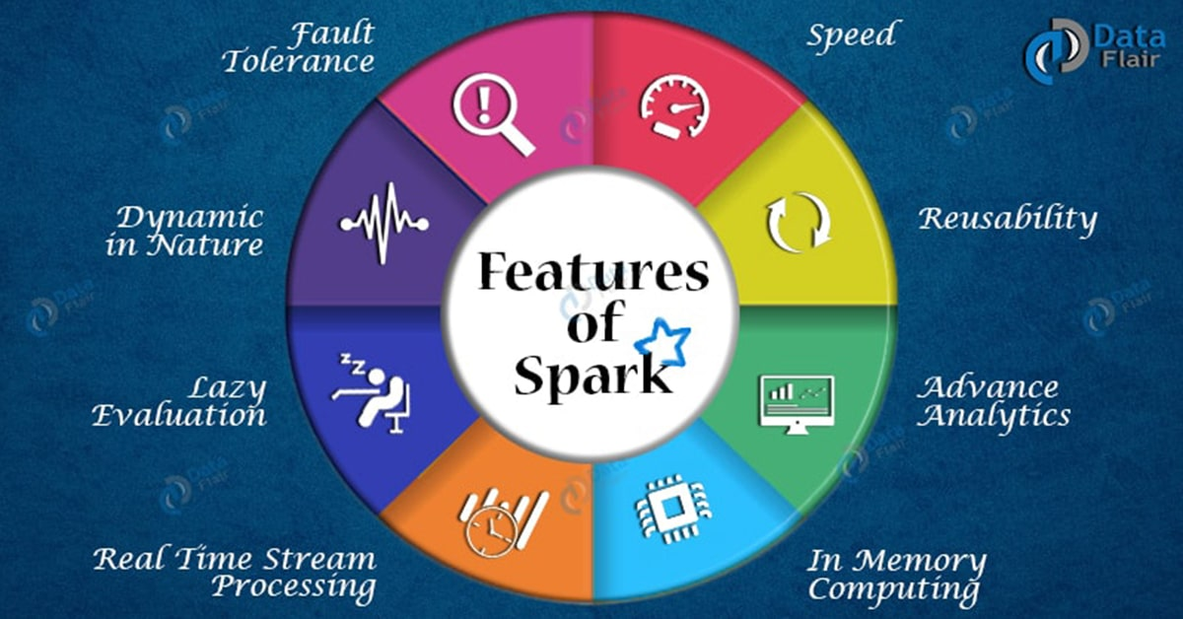
Apache Spark Features

Slide 30
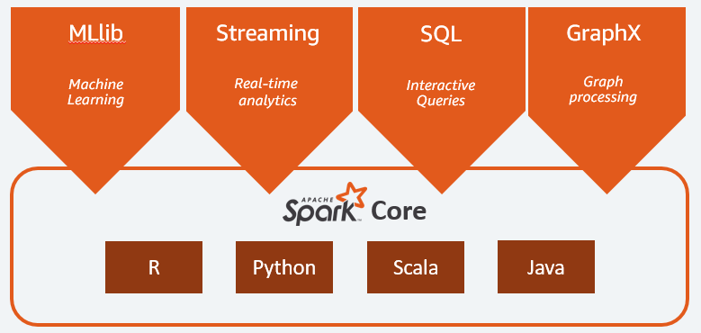
Spark Ecosystem Components

Slide 31
Spark Ecosystem Components
Spark Core: Spark Core is the part of the framework that is responsible for scheduling and running Spark jobs.
Spark SQL: Spark SQL brings native support for SQL to Spark and streamlines the process of querying data stored both in RDDs (Spark’s distributed datasets) and in external sources.
Spark Streaming: Apache Spark Streaming is a scalable fault-tolerant streaming processing system that natively supports both batch and streaming workloads.
Spark Mlib: Spark provides a general-purpose ML library called MLlib, which contains the most commonly used algorithms.
Spark GraphX: Spark allows data to be viewed in terms of vertices and edges in order to perform graph operations.

Slide 32
Spark - Core Concepts
Spark Driver
Spark Executor
Spark RDD
Spark RDD Operations

Slide 33
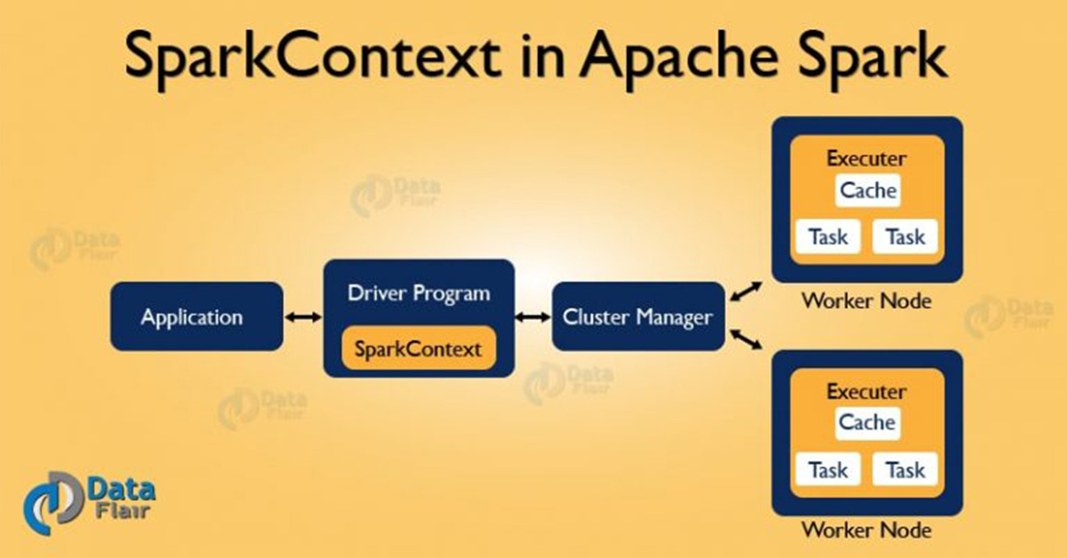
Spark Core Concepts - Spark Driver
Driver in Spark are master nodes.
The most important step of any Spark driver application is to generate SparkContext.
SparkContext allows your Spark Application to access Spark Cluster with the help of Resource Manager.

Slide 34
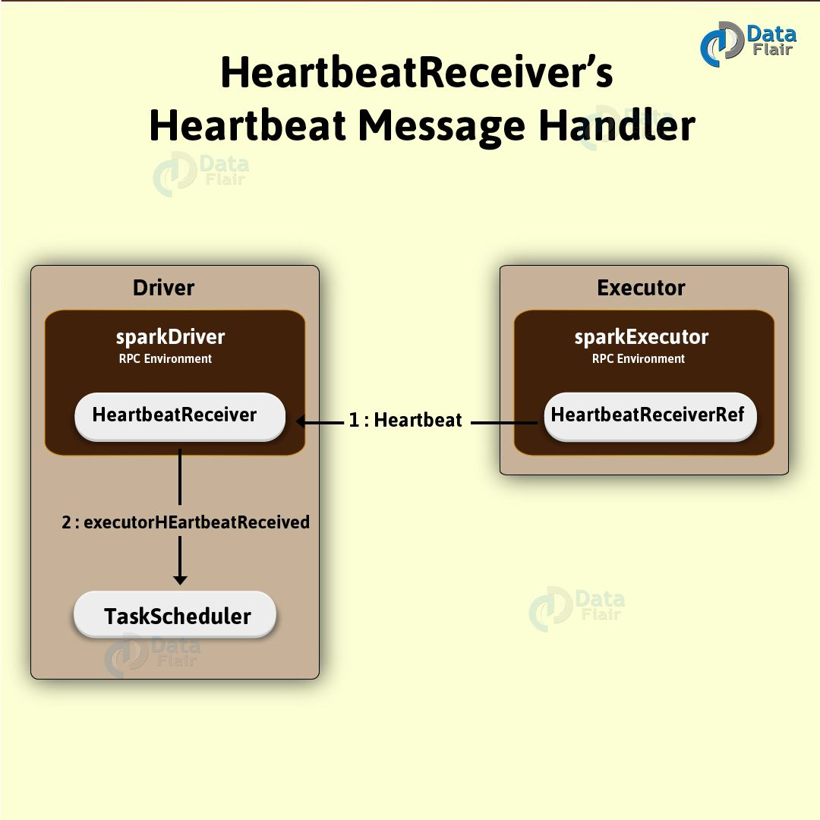
Spark Core Concepts - Spark Executor
In Apache Spark, some distributed agent is responsible for executing tasks, this agent is what we call Spark Executor.
Executors in Spark are worker nodes. It sends results to the driver.

Slide 35
Spark Core Concepts - Spark RDD
RDD (Resilient Distributed Dataset) is the fundamental data structure of Apache Spark which are an immutable collection of objects which computes on the different node of the cluster.
Resilient: fault-tolerant with the help of RDD lineage graph.
Distributed: Data resides on multiple nodes.
Dataset: represents records of the data you work with
Spark RDD can also be cached and manually partitioned.

Slide 36
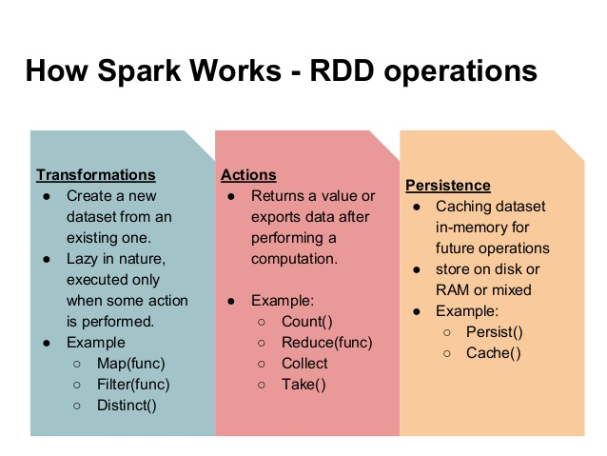
Spark Core Concepts – Spark RDD Operations
There are 2 types of Apache Spark RDD operations:
Transformation: is a function that produces new RDD from the existing RDDs.
Action: when we want to work with the actual dataset.

Slide 37
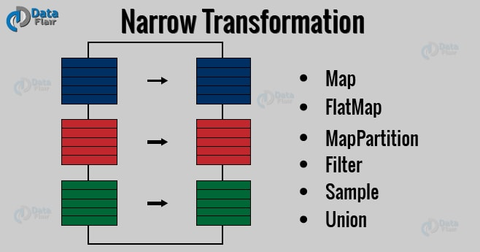
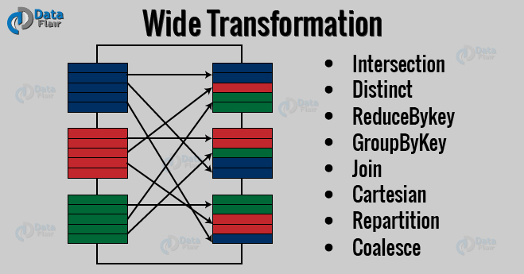
Spark RDD Operations - Transformation
There are 2 types Transformation:
Narrow Transformation
Wide Transformation

Slide 38
Why Spark ?

Slide 40
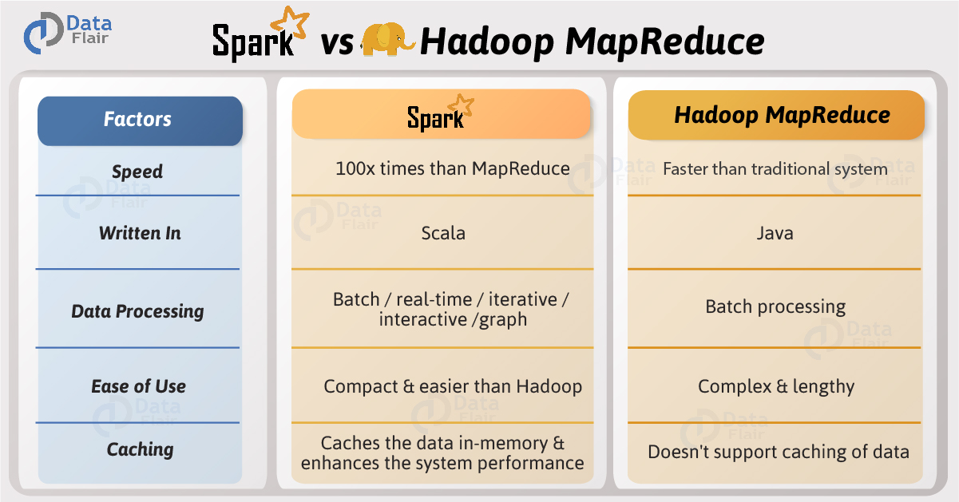
Spark vs Mapreduce

Slide 41
Spark Usecase
Uber – Every day this multinational online taxi dispatch company gathers terabytes of event data from its mobile users. By using Kafka, Spark Streaming, and HDFS, to build a continuous ETL pipeline, Uber can convert raw unstructured event data into structured data as it is collected, and then use it for further and more complex analytics.
Pinterest – Through a similar ETL pipeline, Pinterest can leverage Spark Streaming to gain immediate insight into how users all over the world are engaging with Pins—in real time.
Alibaba is the world’s one of the biggest e-commerce players. Alibaba’s online shopping platform generates Petabytes of data as it has millions of users every day doing searches, shopping and placing orders. The processing of these data points is done using Spark’s Machine learning component MLlib and then used to provide better user shopping experience by suggesting products based on choice, trending products, reviews etc.
Notes:
https://www.knowledgehut.com/blog/big-data/spark-use-cases-applications

Slide 42
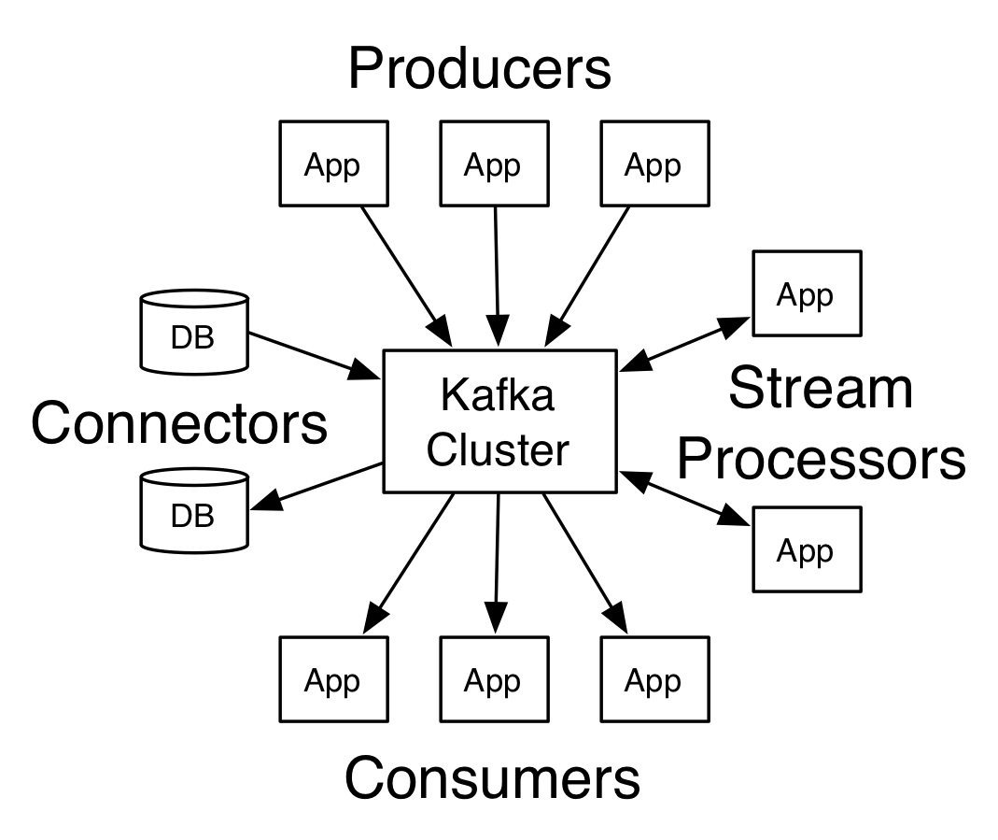
5. Kafka
What is Kafka?
Apache Kafka is a community distributed event streaming platform capable of handling trillions of events a day.
Kafka is used for:
Build pipeline streaming real-time data between application.
Build realtime application that need streaming processing.

Slide 43
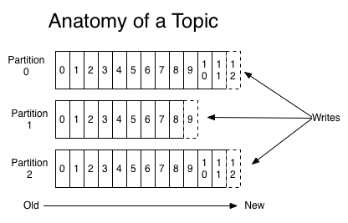
Kafka - Topic
Topic is core Kafka, where record is published.
Record store: key, value, timestamp.
A topic is associated with a log which is data structure on disk.
A topic log consists of many partitions that are spread over multiple files which can be spread on multiple Kafka cluster nodes.
Kafka distributes topic log partitions on different nodes in a cluster for high performance with horizontal scalability.

Slide 44
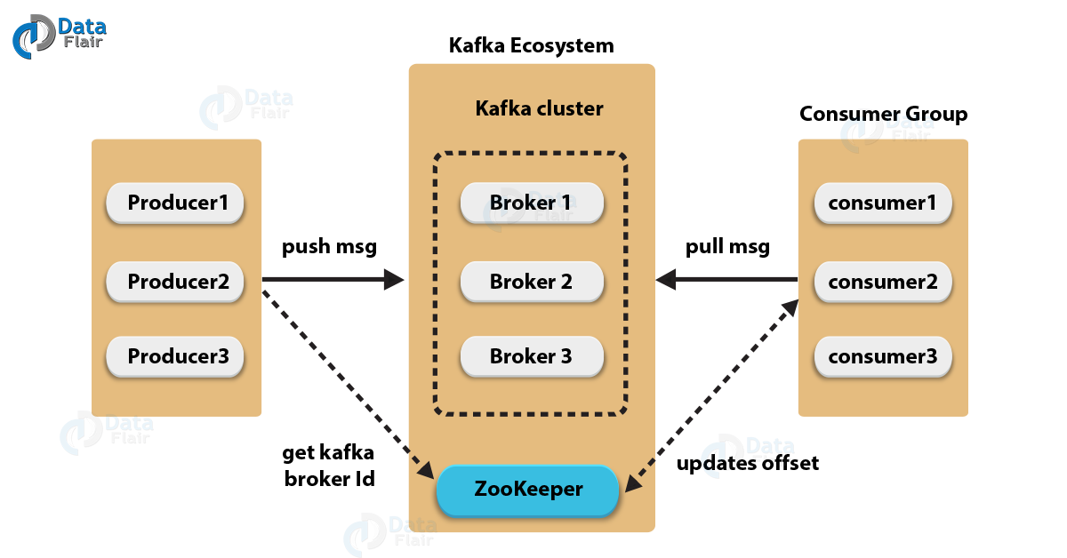
Kafka - Cluster
A Kafka cluster is made up of multiple Kafka Brokers.
Kafka Brokers is where stored topic log partitions.

Slide 45
Kafka - Producer
Kafka producers send records to topics. The records are sometimes referred to as messages.
Default, producer can send records round-robin.
Kafka producers can’t guarantee order of records across partitions.

Slide 46
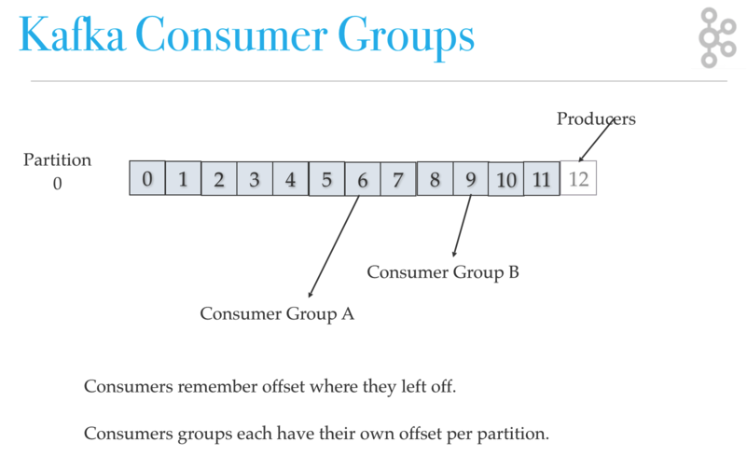
Kafka - Consumer
Applications that need to read data from Kafka use a Kafka Consumer to subscribe to Kafka topics and receive messages from these topics.
Producers write to the tail of these logs and consumers read the logs at their own pace.
Kafka stores offset data in a topic called "__consumer_offset". These topics use log compaction, which means they only save the most recent value per key.

Slide 47
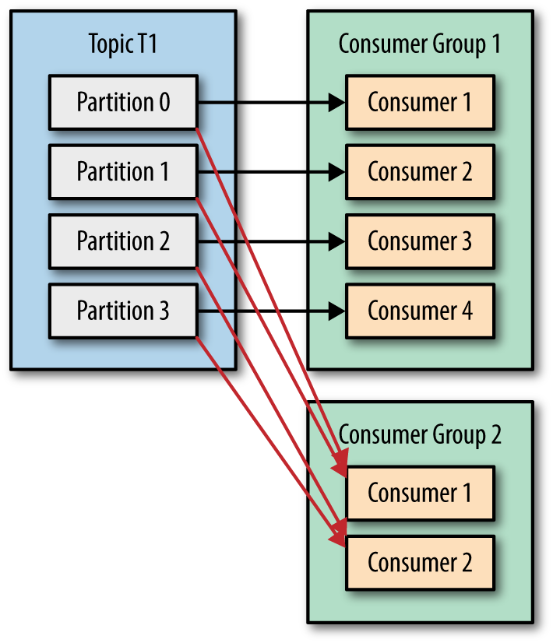
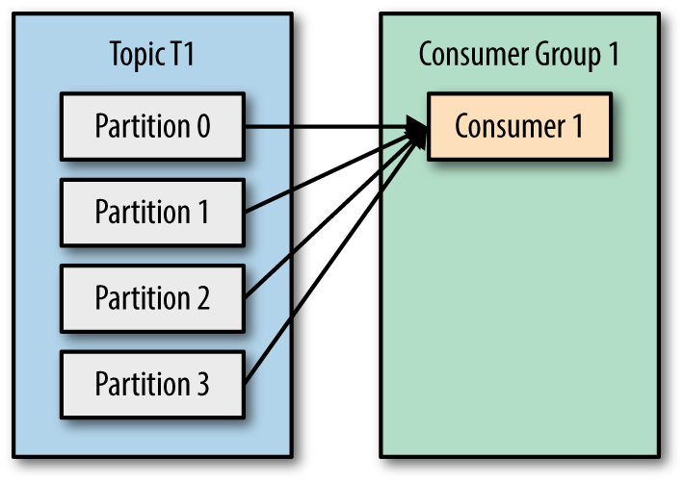
Kafka – Consumer vs Consumer Group
Kafka scales topic consumption by distributing partitions among a consumer group, which is a set of consumers sharing a common group identifier.

Slide 48
Kafka Usecase
LinkedIn’s deployment of Apache Kafka has surpassed 1.1 trillion (yes, trillion with a “t”, and 4 commas) messages per day. This is the largest deployment of Apache Kafka in production at any company (2019)
Netflix operated 36 Kafka clusters consisting of 4,000+ broker instances for both Fronting Kafka and Consumer Kafka. More than 700 billion messages are ingested on an average day (2016)
Pinterest have >2,000 brokers running on Amazon Web Services, transporting >800 billion messages and >1.2 petabytes per day (2018)
Other company using Kafka: CloudFlare, Uber.
Notes:
https://medium.com/netflix-techblog/kafka-inside-keystone-pipeline-dd5aeabaf6bb

Slide 49
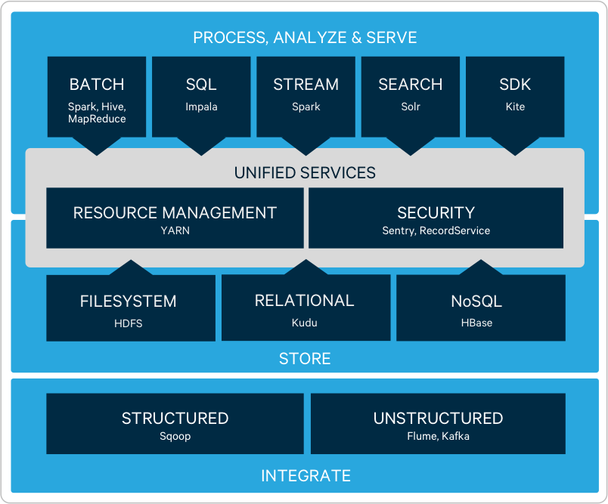
6. Bigdata Stack GHTK

Slide 50
Thank you !!!

